Slide 1
Some Optical Illusions
B Ricks PhD, Spring 2018
Most content from https://www.washingtonpost.com/news/wonk/wp/2015/02/27/12-fascinating-optical-illusions-show-how-color-can-trick-the-eye/?utm_term=.34ad7d7e726d

Slide 2
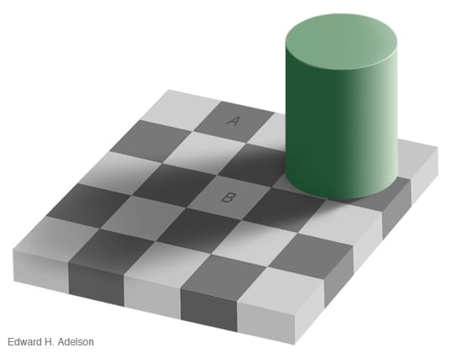

Slide 3
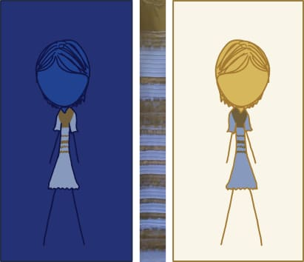

Slide 4
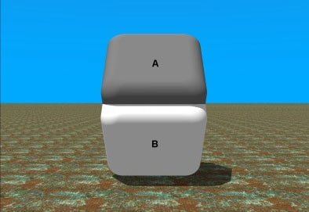

Slide 5


Slide 6
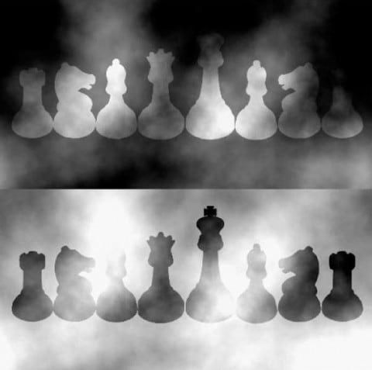

Slide 7
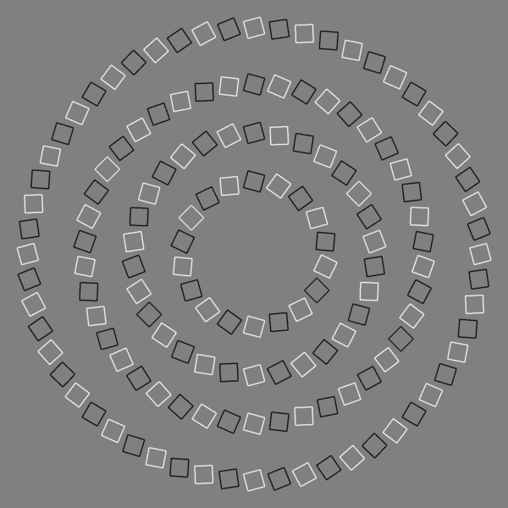

Slide 8
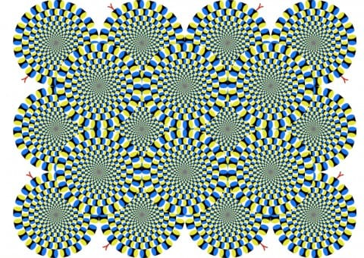

Slide 9


